Slide 1


A SWOT ANALYSIS OF EKSU VENTURES AND RECOMMENDATIONS FOR PROPELLING WEALTH CREATION FOR THE UNIVERSITY
BY:
PROF. IBIYINKA OGUNLADE
Acting Director EKSU Ventures

Slide 2
INTRODUCTION
The ability to turn opportunities into money-making ventures requires an appropriate environment where resources, ideas, skills and knowledge (RISK) can be harnessed to create wealth for continued financial sustenance, especially in EKSU.
Hence A SWOT analysis of EKSU Ventures.

Slide 3

EKSU Ventures are categorized into three (3): the existing ventures, proposed ones and consultancy Services.
CATEGORY A: Existing Ventures comprising:
GUEST HOUSE
PRINTING PRESS
BLOCK INDUSTRY
CATEGORY B: Proposed Business Ideas
WATER BOTTLING
BAKERY
STAFF CANTEEN
BOOKSHOP
PETROL STATION
CAR WASH
CATEGORY C: Consultancy Services

Slide 4
CATEGORY A
GUEST HOUSE
PRINTING PRESS
BLOCK INDUSTRY

Slide 5
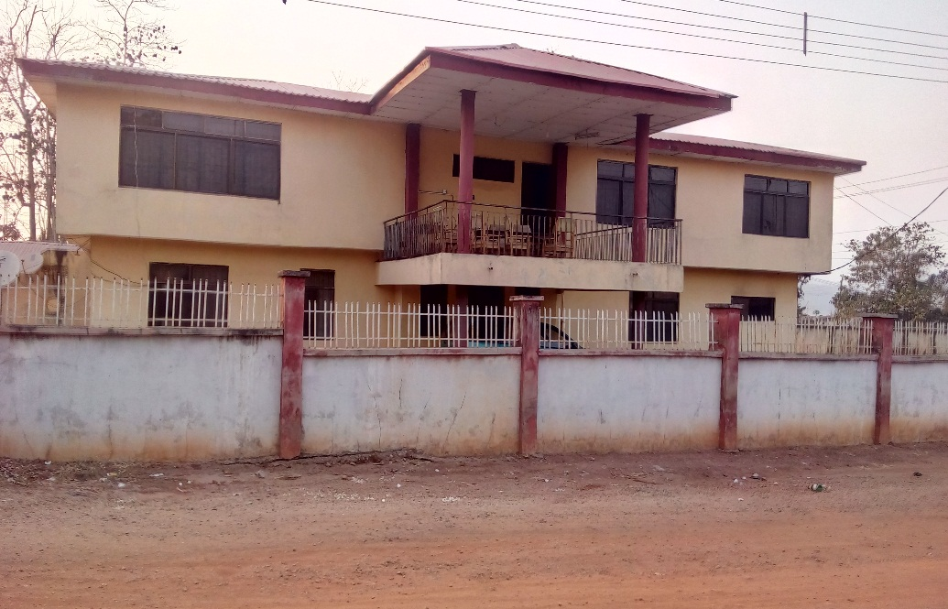
EKSU GUEST HOUSE
The Guest House offers Restaurant, Accommodation, Bar Services and Outdoor Catering Services
STRENGTH
The location is at the heart of the town for easy
accessibility (around Fajuyi Park)
Closeness to State Secretariat, GRA and Banks
Patronage from visitors from other Universities
Security of lives and properties are guaranteed
Ekiti State University is our major customer

Slide 6
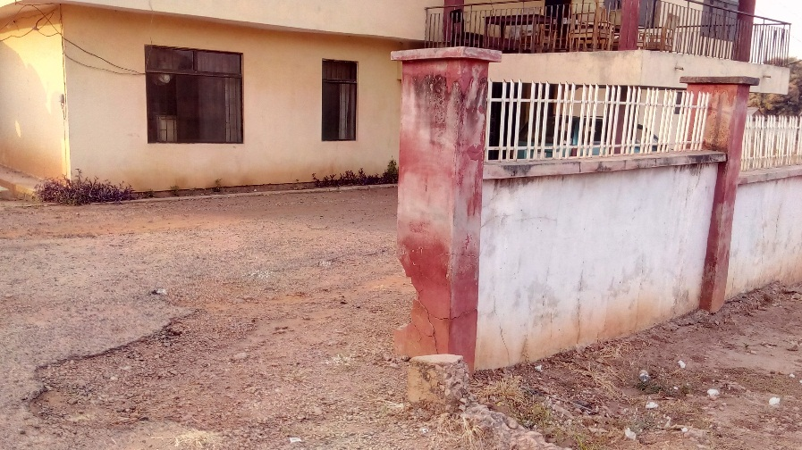
WEAKNESS
The building was not initially structured to house a Guest House
The Restaurant can not accommodate not more than ten 10 customers at a time
Poor patronage because of unfriendly environment (poor landscaping) and inadequate advertisement
Inadequate kitchen facilities
Furniture, beds, beddings and toilet facilities are obsolete, hence not meeting the current taste and needs of customers
Low standard bar

Slide 7
OPPORTUNITIES
The name EKSU is ‘a good will’ to enhance patronage
The Guest House is located at the Bank/Secretarial Road, Ado-Ekiti where it could enhance maximum patronage from Bankers, Politicians, Civil Servant and business men.
The unused large space in the Guest House complex could be developed to house a modern structure for the Guest House
A pavilion could be erected outside the building as a ‘seat out’ for Asun, Suya, Pepper soup and barbeque.
Abandoned University’s houses at Ekiti State Housing and GRA could be annexed to the Guest House to avoid wastage

Slide 8
THREATS
Competition with modern hotels in the vicinity
Delaying in payment for services to the University, Departments and Units
Verbal and improper booking by staff and some units in the university
Most Guest House services had been hijacked
RECOMMENDATIONS
Government functionaries, politicians, tourists etc should be encouraged to patronize EKSU Guest house through advertisements via Posters, jingles etc.
The Guest House should be renovated immediately

Slide 9
PRINTING PRESS
The Press is enjoying some level of patronage from the University in terms of printing of official document and preserving integrity of University’s official document
STRENGTH
Established Business Structure
Quasi-Experienced Staff
Spacious and Extendable Premises
Durable and Serviceable Machines
Accessible location and Close Proximity to Business Target
Qualified and Competent Graphic and Machine Operators
Low Risk of Failure and Default

Slide 10
WEAKNESS
Absence of Experienced Press Manager
Inadequacy of Finishing Labour for large volume of work
Proximity of Servicing Engineers
Bureaucracy in the Release of Funds for Job Execution
Low Staff Remuneration
Lack of well Secured Premises

Slide 11
OPPORTUNITIES
Huge Volume of Printing Materials within the University
Generations of Large IGR for the University
Extension of Limited Service to Public for more revenue Generation
Acquisition of State of Arts Printing Machines for easy and efficient operation such as D1 offset machines
Support for the proposed EKSU Bookshop

Slide 12
THREATS
Loss of patronage
Huge debt profile
Porosity of security of premises
Poor monitoring of workers activities due to absence of press manager
Over pricing of Jobs
Possible sharp practices
Inadequate running grant
RECOMMENDATIONS
All printing jobs within the University should be given to the printing press henceforth (Mandatory).
The financial records of the press should be made more transparent
An experienced Manager should be recruited

Slide 13
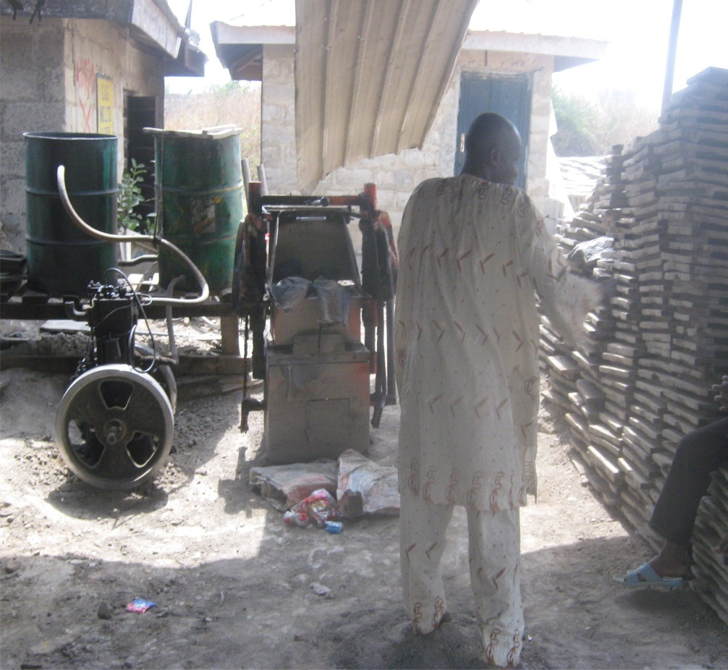
EKSU BLOCK INDUSTRY
In view of the massive constructions on campus and large population of ‘prospective house owner’ staff, EKSU Block industry is a viable investment.
STRENGTH
Existing Business Structure
Availablility of land for expansion
Accessibility to market
High Quality Products
Low risk of Failure and Default

Slide 14
WEAKNESS
Inadequate patronage
Paucity of funds
Level of involvement of a third Party Company in the Block Industry

Slide 15
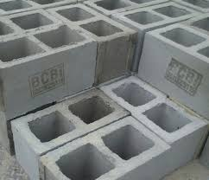
OPPORTUNITIES
Availability of market
Access to modern technologies
Large Employment opportunities

Slide 16
THREATS
Periodic check from SON
Outside competitors
RECOMMENDATIONS
A special credit and Installment agreement should be given to the staff
Contractors of structures on campus should purchase blocks from the University
EKSU indigent students with block making experience should be engaged on a work study programme

Slide 17
CATEGORY B
Proposed Business Ideas
WATER BOTTLING
BAKERY
STAFF CANTEEN

Slide 18

EKSU WATER BOTTLING
INTRODUCTION
EKSU Quality water will serve the University community, the State and his environs if established.
EKSU NATURAL WATER
EKSU WATER
EKSU WATER
EKSU WATER

Slide 19
STRENGTH
Water is a natural resource and a readily available raw material
Large market outlets of about 10000 staff and students.
Large acreage of land free from academic environment
Qualified EKSU experts for water analysis and registration
Image of the University to build on
Industrial training avenue for SIWES students

Slide 20
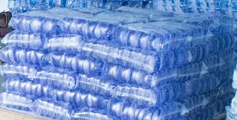
SWOT ANALYSIS (WATER BOTTLING)
WEAKNESS
Competition from other suppliers
Erratic power supply on Campus
OPPORTUNITY
Capacity to capture different segments of the society
Advertisement of the image of the University
Opportunity for best technology

Slide 21
SWOT ANALYSIS (WATER BOTTLING)
THREAT
Cost of maintenance of vehicles and machine
Industrial action by Staff and Students
Bureaucracy in the management structure
Purchase of fake pre-forms
Constant inspection by NAFDAC officials
Unavailability of skill personnels
RECOMMENDATIONS
A feasibility study should be carried out on the water bottling /sachet industry
NAFDAC requirements should be complied with

Slide 22
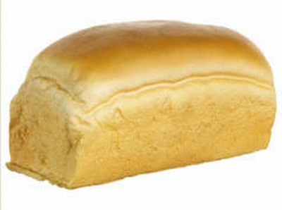
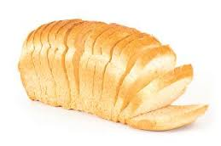
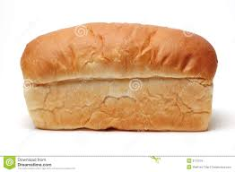
BAKERY
Bread is largely eaten by both students and staff on daily basis
STRENGTH
Availability of market for the product (students and staff)
Availability of land on which the business can be sited
High Quality product is guaranteed (Bromate-free)
Certification process by NAFDAC, SON etc. would be made easy because EKSU is blessed with members of professional bodies that are relevant in the field

Slide 23
WEAKNESS
Management of the organization
Bureaucracy in the management system
Shortage of capital ( fund and funding)

Slide 24
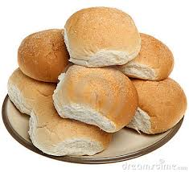
OPPORTUNITIES
Access to best technologies available
High quality bakery products
Opportunity of boosting the internally generated revenue (IGR) of the University
Employment opportunity for the unemployed
Training of IT and SIWES students
Boosting the image profile of EKSU

Slide 25
THREATS
Strike actions by unions and students leading to the closure of the institution
Maintenance cost of equipment and machines
Competition with other vendors engaging in bakery products
Periodic checks from NAFDAC, SON etc.
RECOMMENDATIONS
A feasibility study should be conducted on the establishment of EKSU bakery
The bakery should commence soonest

Slide 26
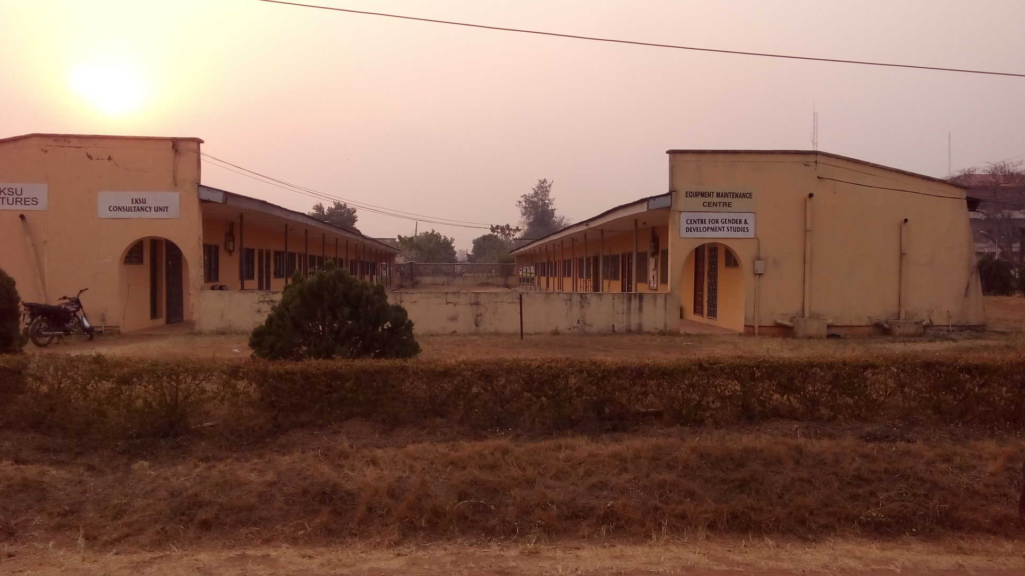
INTRODUCTION
EKSU STAFF CANTEEN
The proposed take off location of the Staff Canteen is any of the old Faculty buildings e.g (Management Sciences old building)

Slide 27
EKSU STAFF CANTEEN
STRENGTH
Large population of staff on campus and their visitors will boost patronage.
Worthwhile opportunity for recreation during and after office hours.
Relaxation will reduce stress and enhance productivity among staff.
Annex to the Guest House
Forum for better inter-personal relationship among staff.

Slide 28
EKSU STAFF CANTEEN
WEAKNESS
Canteen could be turned to a political arena if not well managed
Paucity of fund
Strike actions on campus

Slide 29
EKSU STAFF CANTEEN
OPPORTUNITY
Existing Faculty of Management Sciences old building could be converted to reduce take off fund
Proposed location is very accessible and centrally located
Provision of venue for Procurement of snacks, food and drinks.
Opportunity for staff to entertain guests
Facility for entertainment of colleagues during ceremonies

Slide 30
THREAT
(STAFF CANTEEN)
Competition with existing food vendors and snacks joints on campus
Credit sales could serve as threat if not put to check
Inter and intra-union conflict/dichotomy may cause division

Slide 31
RECOMMENDATION (STAFF CANTEEN)
Management should set up a committee to determine the financial implication of the items required for establishing the canteen.
Rules and regulation to guide the centre should jointly be drafted by all the unions on campus

Slide 32
OTHER BUSINESS IDEAS
CATEGORY C
EKSU CONSULT

Slide 33
EKSU CONSULT
EKSU Consult organizes training and manpower development services and runs professional programmes
STRENGTH
Available structure and man power exists in EKSU
University is well known locally and Internationally for patronage

Slide 34
WEAKNESS
Inadequate patronage at current centers
Large distance to cover for coordination, quality assurance and standardization

Slide 35
OPPORTUNITIES
Accessibility to large market of candidates seeking Knowledge
Availability of adjunct lecturers from neighbouring institutions
EKSU established good image

Slide 36
THREATS
Competition from sister Universities
Transparency of personnel
Quality control and effective record management
RECOMMENDATIONS
Management team with maximum commitment should be saddled with the responsibility of EKSU Consultancy services
Professional examinations such as ICAN, ANAN or ATS, Executive MBA and new postgraduate diplomas should be floated on weekends

Slide 37
ACKNOWLEDGEMENT
I want to recognise/acknowledge the tremendous support of my working committee
Dr. R. O. Famiwole
Dr. R. O. Akinyeye
Dr. A. Ojo
Dr (Mrs.) F. A Adebayo.
Dr. (Mrs) K. A Omotayo
Dr. M. A. Azeez
Mr. S. O. Afolabi
Mr. A. J. Adesina
Mrs. F. I. Aribisala
Mrs. O.O. Idowu

Slide 38
QUESTIONS
?

